Slide 1
Study of Various materials in Through silicon vias
November 25th , 2014
Guidance By- Presented By-
Dr. Derej e Agonafer Nupoor Korde (1001106063) Swapnil Harel (1001151374) Nihar Dandekar (1001166155) Gopal Gulwani (1001154755) Pavan Agarwal (10011549880)

Slide 2





Project By
Nupoor Korde (1001106063)
Swapnil Harel (1001151374)
Pavan Agarwal (10011549880)
Nihar Dandekar (1001166155)
Gopal Gulwani (1001154755)

Slide 3
Objective
OBJECTIVES
To compare various materials like copper, aluminum, and tungsten as TSVs
To provide a probable solution to mitigate the challenges that are being encountered due to metallic vias: Carbon Nano-tubes

Slide 4
Outlineline
Definition : Vias
Through Silicon Vias (TSVs)
Comparison of metal properties
Analysis of Cu and Al
Carbon Nanotubes- a probable solution (?)
Properties of CNTs
Integration of CNTs
Conclusion

Slide 5
DEFINITION: Vias
Vertical Interconnect Access: VIAs
Increase in level of sophistication has led to vertical expansion of integrated circuits- 3D technology
Low power and high performance devices
Multiple layers of die/packages stacked vertically
Inter-layer connection

Slide 6
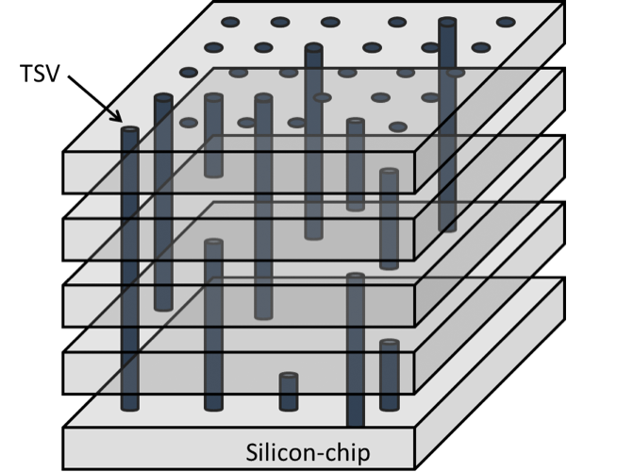
Through Silicon Vias
Pass completely through Si wafer
Popular via metals- Al, Cu, W
Electrical contact established between layers in z- direction
Good performance due to high density and shorter length of vias
Figure 1 TSVs
Source: http://electronicsbus.com/through-silicon-vias-tsv-technology-smart-3d-ic-package-chip-integration/

Slide 7

Through Silicon Vias (contd.)
Heating due to bulk resistivity
Stress issues due to thermal expansion
Timing delays
Coefficient of Thermal Expansion (CTE)
16.7x10⁻⁶/ ºK for Cu
3x10⁻⁶/ ºK for Si
CTE mismatch!!
Tungsten is a more practical solution to avoid this problem

Slide 8
Summary of comparison
Properties | Material
 | Copper | Tungsten | Aluminum
Young’s Modulus (GPa) | 110-128 | 411 | 70
Thermal Conductivity (W/m.k) | 401 | 173 | 237
Thermal Expansion at 25◦C (μm/mK) | 16.5 | 4.5 | 23.1
Density (g/cc) | 8.96 | 19.3 | 2.702
Specific heat ( J/kg-K) | 385 | 134 | 900

Slide 9
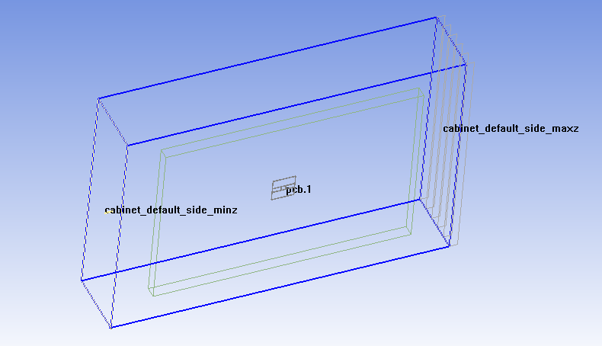
MODELLING OF tsv
Fig. 2 Model in Icepak

Slide 10
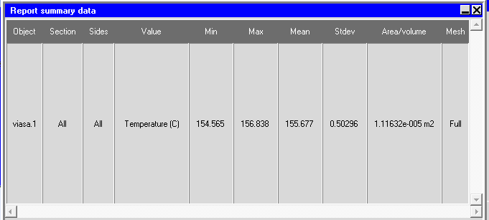
Analysis of ALUMINUM tsvs
Fig. 3 Thermal analysis of Al

Slide 11
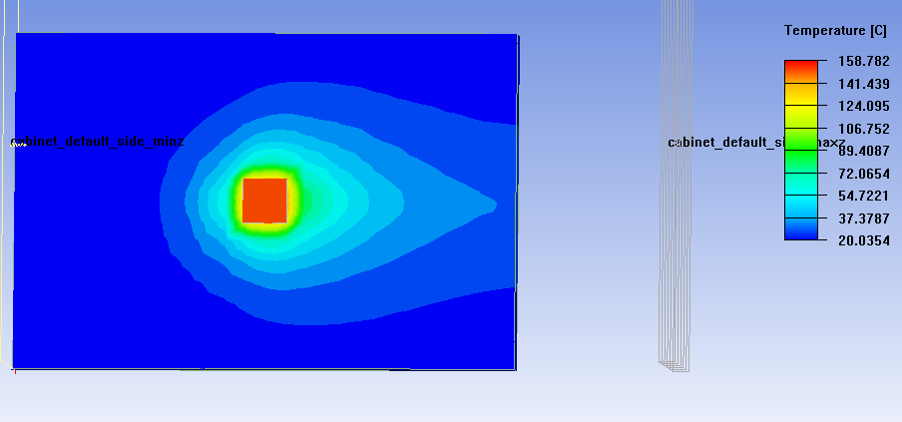
Analysis of copper tsvs
Fig. 4 Thermal analysis of Cu

Slide 12
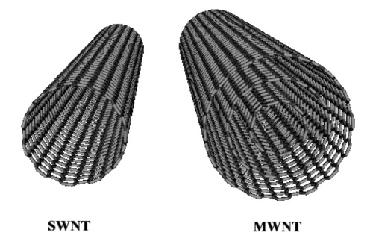
Carbon Nano-Tubes
Allotropes of carbon
Graphene sheets wrapped to form cylindrical structure
Diameter of the order of few nanometers and length going up to meters
Types- single walled and multi-walled
Fig. 5 Types of CNTs
Image source: http://itech.dickinson.edu/

Slide 13
PROPERTIES OF CNT
High tensile strength
High thermal conductivity
Ballistic conduction
Young’s Modulus: ~1000 GPa
Thermal Conductivity: >3000 W/m-K
Thermal Expansion at 25◦C: 20 μm/m-K
Density: 1.3- 2 g/cc

Slide 14
Integration of cnts as vias
Fig. 6 Top down and bottom up processes
Image source : Vollebregt, Sten, et al. "Carbon nanotubes as vertical interconnects in 3D integrated circuits." (2009)

Slide 15
Conclusion
CNTs seem to be an ideal choice for next generation vertical interconnect access technology due to its properties and advantages over the conventional metals.
CNTs have high conductance and their current carrying capacity is multifold than copper which make them suitable for micro-scale electronic applications.

Slide 16
References
Goplen, Brent, and Sachin S. Sapatnekar. "Placement of thermal vias in 3-D ICs using various thermal objectives." Computer-Aided Design of Integrated Circuits and Systems, IEEE Transactions on 25.4 (2006): 692-709.
Majumder, Manoj Kumar, et al. "Signal Integrity Analysis in Single and Bundled Carbon Nanotube Interconnects." Journal of Nanoscience 2013 (2013).
Liu, Chang, and Sung Kyu Lim. "A study of signal integrity issues in through-silicon-via-based 3D ICs." Interconnect Technology Conference (IITC), 2010 International. IEEE, 2010.
Hu, X. U. Modeling and Design Techniques for 3-D ICs under Process, Voltage, and Temperature Variations. Diss. ÉCOLE POLYTECHNIQUE FÉDÉRALE DE LAUSANNE, 2012.
Gerke, David. "NASA 2009 Body of Knowledge (BoK) through-silicon via technology." (2009).
Okoro, Chukwudi, et al. "Synchrotron-based measurement of the impact of thermal cycling on the evolution of stresses in Cu through-silicon vias." Journal of Applied Physics 115.24 (2014): 243509.
Vollebregt, Sten, et al. "Carbon nanotubes as vertical interconnects in 3D integrated circuits." (2009).
Pavlidis, Vasileios F. Interconnect-based design methodologies for three-dimensional integrated circuits. Diss. University of Rochester, 2008

Slide 17
THANK YOU!

